Slide 1
The Anatomy of: a Good Code Review
Elizabeth Groom – That Conference 2020 2021

Slide 2
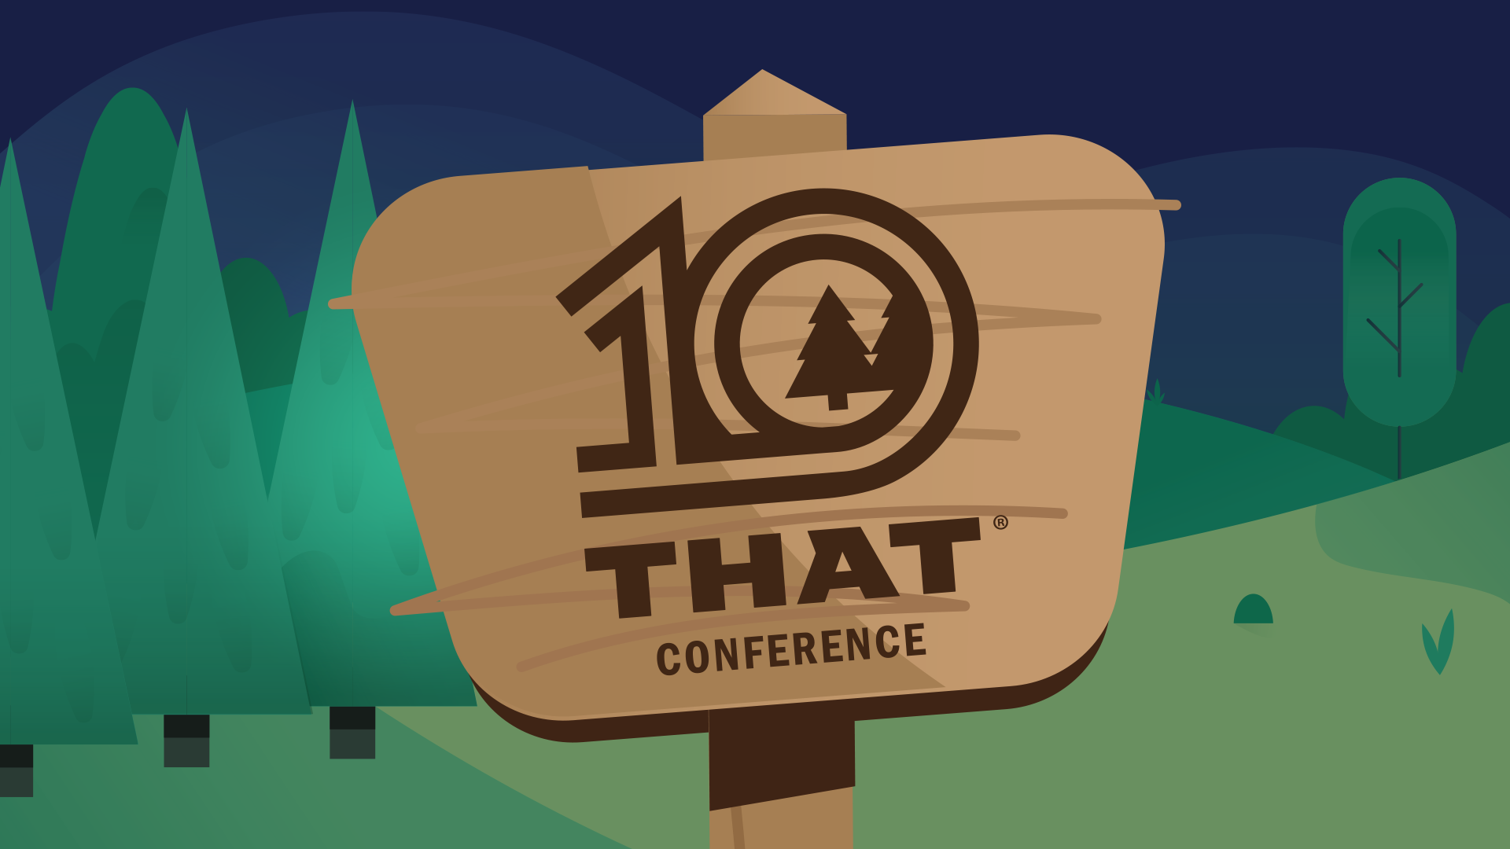

Slide 3
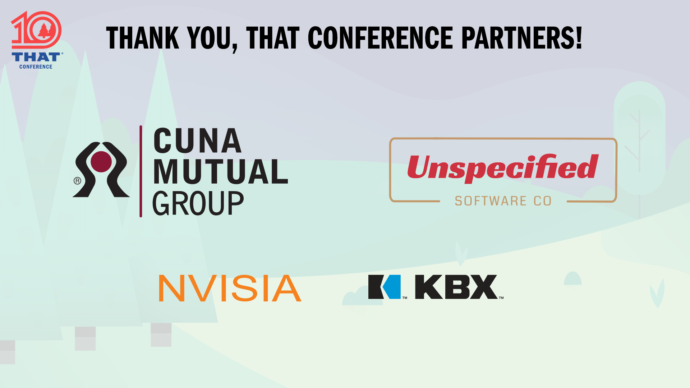

Slide 4
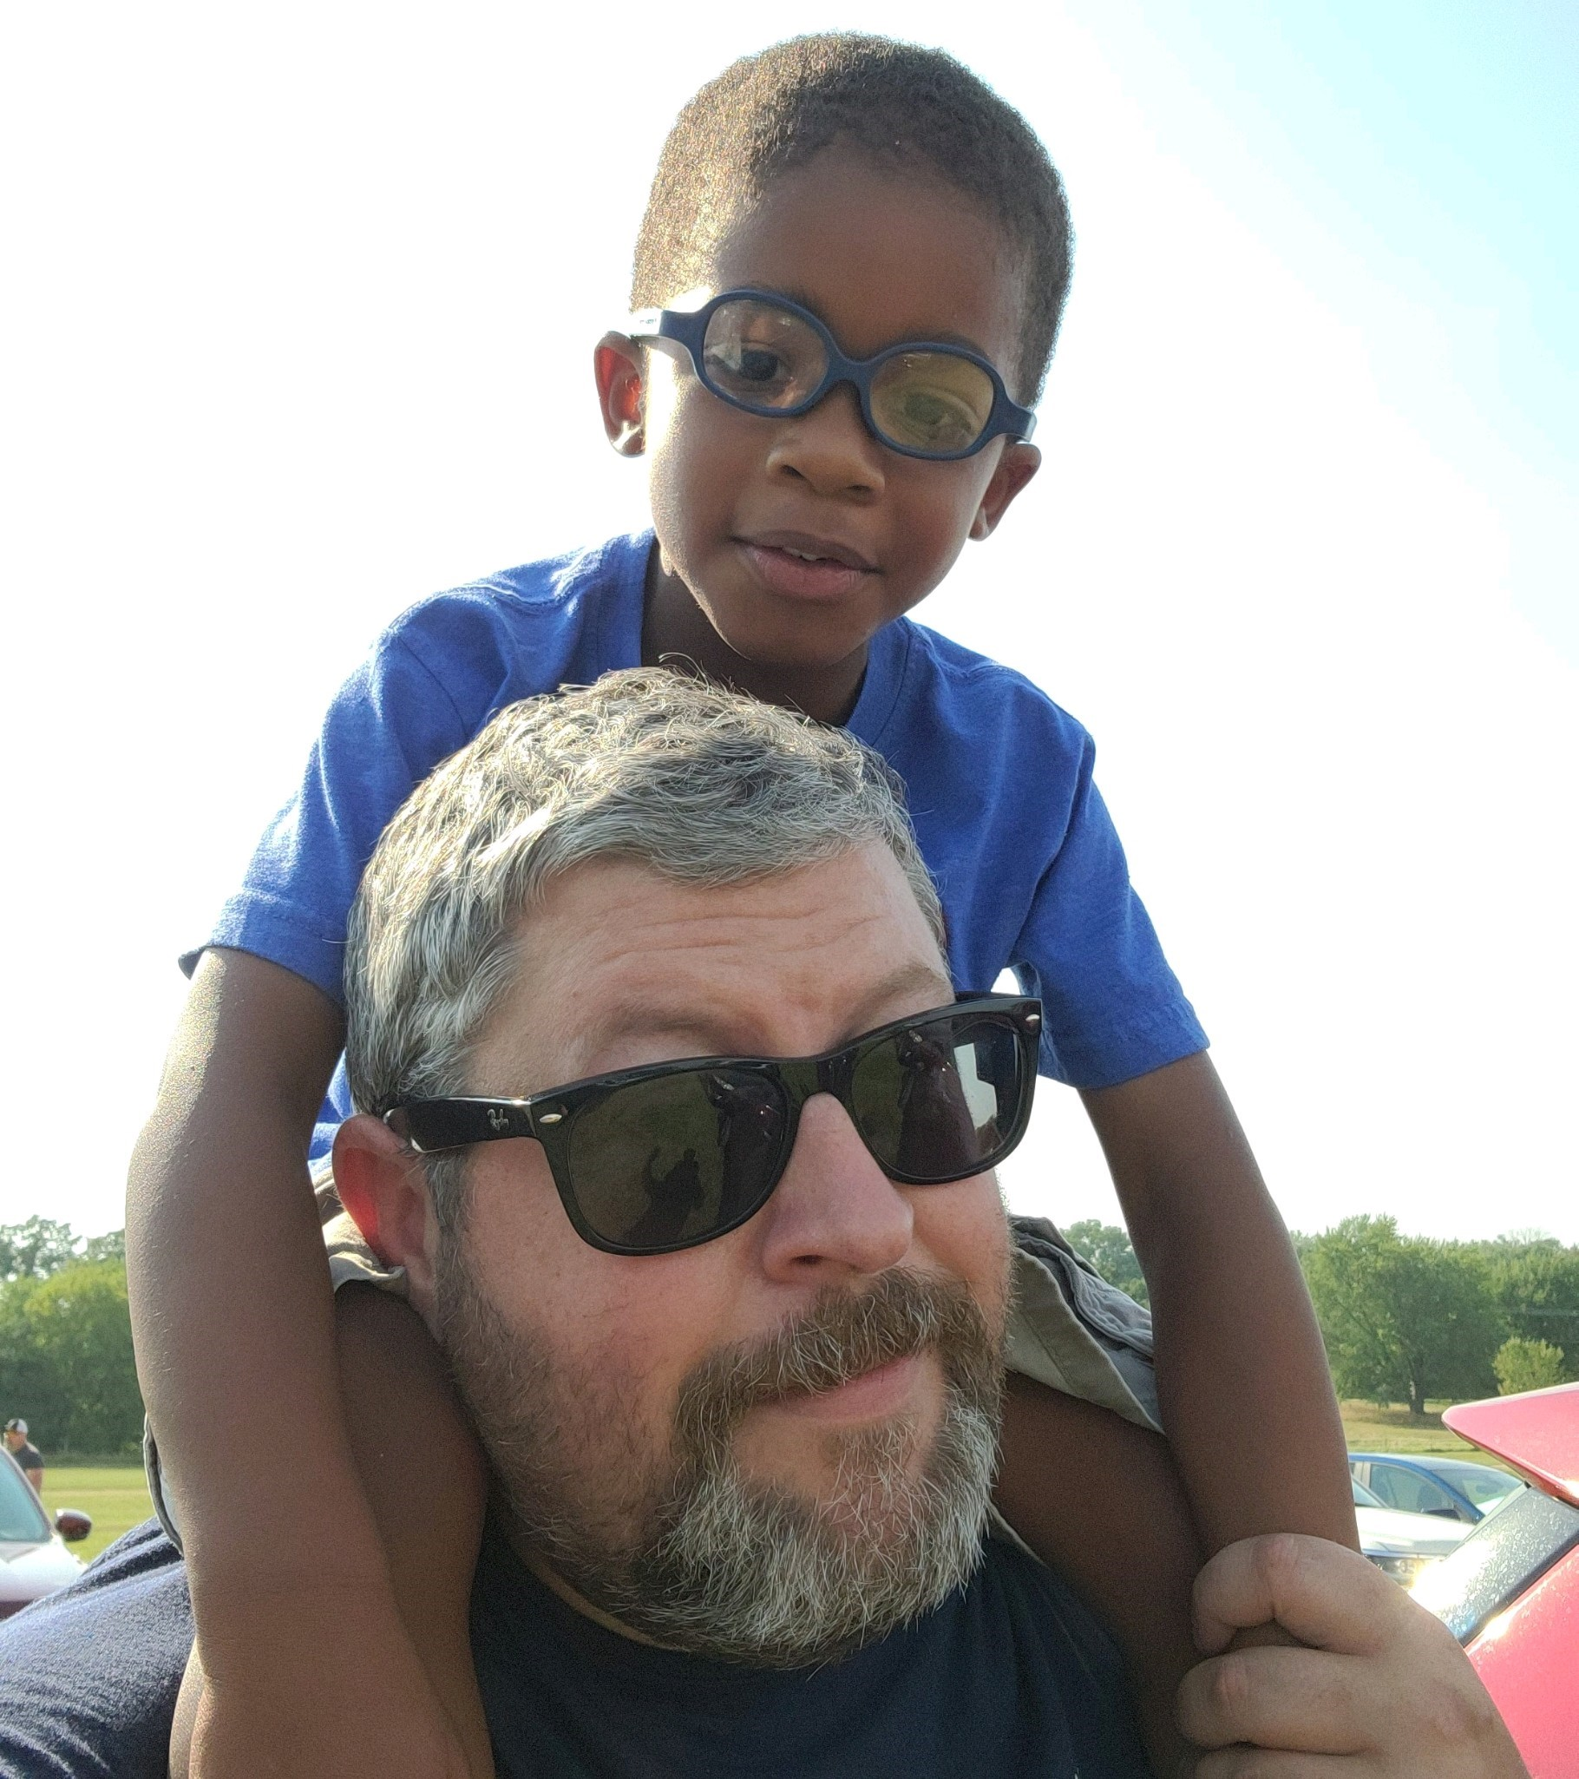
Who am i?
Elizabeth Groom
Mom\Wife
Teammate
Software Developer

Slide 5
What is a code review
“ A software quality assurance activity in which one or several humans check a program mainly by viewing and reading parts of its source code” –Wikipedia
Teammates getting together and agreeing that what was written was what was expected, is quality and it meets our definition of done. -Me

Slide 6
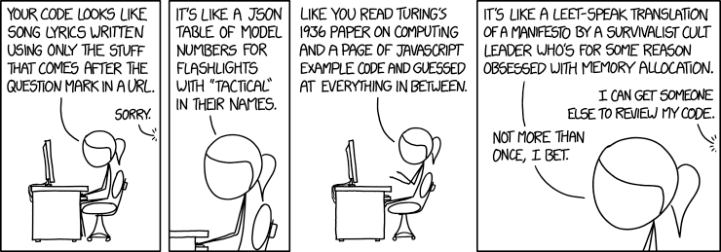
What a code review is not
A chance to show off how much better of a developer you are.
A time to nitpick another teammates style.
A meeting that includes folks outside of your scrum team.

Slide 7
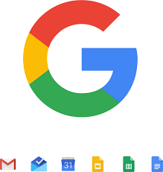


Consider this
At Google and Apple code reviews are an important part of their process.
“Both companies closely tie code reviews to their development culture; they ‘bake’ code reviews into Agile sprints and iterations to identify potential defects earlier in their cycles. At these companies, code is never “checked-in” before it is reviewed. ”
Microsoft dose not enforce a code review as part of their development process.
“Unlike Microsoft, Apple and Google are sticklers for code review, and their product quality reflects this added effort.”
Source: Code Review: An Agile Process
Notes:
Source: https://smartbear.com/learn/code-review/agile-code-review-process/

Slide 8
What code reviews can offer
Better code quality – improve internal code quality and maintainability (readability, uniformity, understandability, ...)
Finding defects – improve quality regarding external aspects, especially correctness, but also find performance problems, security vulnerabilities, injected malware, ...
Learning/Knowledge transfer – help in transferring knowledge about the codebase, solution approaches, expectations regarding quality, etc; both to the reviewers as well as to the author
Increase sense of mutual responsibility – increase a sense of collective code ownership and solidarity
Finding better solutions – generate ideas for new and better solutions and ideas that transcend the specific code at hand.
Complying to QA guidelines – Code reviews are mandatory in some contexts, e.g., air traffic software
Source: Wikipedia
Notes:
Also
Normalize Failure
Few things empower newer team members or younger coders more than spotting a bug introduced by a senior developer. It helps everyone realize and accept that everyone makes mistakes. It’s important to understand that failure, mistakes, and bad approaches are just part of being a developer. We need to normalize the failure and discovery process.
The code review also serves as a safety net which can empower developers to try new things, since they know it will receive adequate verification.
This is important because those who no longer fear taking risks and making mistakes tend to outgrow and outperform those who only work within their comfort zone.
https://dzone.com/articles/the-most-important-developer-practice

Slide 9
Ways to do a code review
Scheduled Meeting
Over the shoulder
Pair programming
Pull request reviews
Notes:
Over-the-shoulder
This is the easiest technique of all: when it is time for a code review, find a developer and sit down with him or her in front of the code. Face-to-face communication is an easy, high-bandwidth medium for the author’s explanation of the code.
Pair programming.
A key contribution from the Extreme Programming world is pair programming, which in some ways is a continuous code review. A great way to share expertise and promote the mentoring of more junior developers, pair programming review comes with both high overhead and the risk that the reviewer is too “close” to the code, making the review less effective.
https://smartbear.com/learn/code-review/agile-code-review-process/

Slide 10
Code review roles
Author
Reviewer

Slide 11
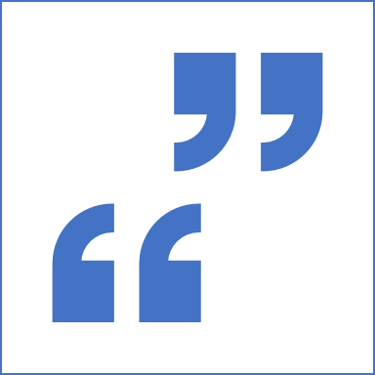
Author
Who: Writer(s) of the code
Responsibilities:
Write readable, testable code you are proud of
Create a clear concise statement of what you wrote and why
Clearly relate the code to a requirement from the client
Prepare for the review, being ready to answer questions and demo the code

Slide 12
Reviewer
Responsibilities:
Look through the code, looking for:
Design flaws
Logic Errors
Memory leaks
Possible performance issues
Does it meet the client’s requirements
Does it meet the Architectural Design
Automated tests written cover the new code
Code Maintainability
Code Readability
Security Vulnerabilities
Coding Standards like SOLID and DRY principles
Add comments to areas of the code that you see as needing attention
Who: Any other team member(s) that was involved in the planning of the work item or can be spun up.

Slide 13

How to be a good reviewer
Be Considerate and Constructive
Take it Seriously and Be Thoughtful
Ask Questions
Be Timely
Notes:
Assume Best Intentions

Slide 14
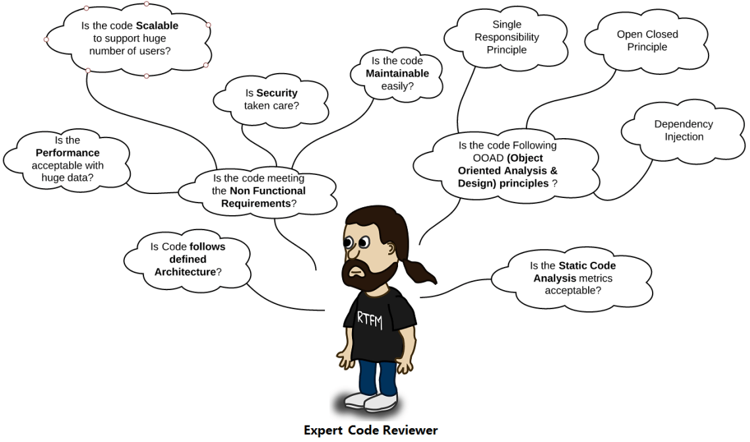
Going from a good reviewer to great
If you don't understand or wonder why something was done a certain way ask!
You can to pull down the code and run it locally to check things out.
Be involved enough to be able to take ownership of the code.
Image Source: Details Code Review Checklist
Notes:
You can pull down the code and run it locally to check things out like:
What is the code coverage of the unit tests?
I wonder how this works? Debugging might help!
Linting checks
Be accountable.
You are putting your name on this code right next to the authors. Make sure you are confident in it and could take it over when the author wins the lottery.
Review triggers a new idea\approach – bring it to the team!

Slide 15
Traps to avoid
Rubber stamping your approval.
Thinking “I’m sure they know why they did this, I’m not going to ask.”
Inheriting the author's biases.
Putting too much ceremony around code reviews
Thinking “Well it’s done now, its not worth mentioning….”
Notes:
Inheriting the author's biases: Asking for an explanation and not really understanding it but accepting it: then you don’t understand what a part of the new code does, what do you do? You ask the author. And then he or she explains this part and then the rest. Now you’re reviewing the code with the author. You will inherit the author’s biases. Everything you read is within the lens of the author’s view, making you understand things you will not understand next time you read them unless you remember the explanation. And you might even agree with things you would not to, due to context. Source: https://www.codacy.com/blog/how-to-code-review-in-a-pull-request/
too much ceremony\in flexible around it and it will take too much time and get dropped form the process
Broken Windows Theory:
In inner cities, some buildings are beautiful and clean, while others are rotting hulks. Why? Researchers in the field of crime and urban decay discovered a fascinating trigger mechanism, one that very quickly turns a clean, intact, inhabited building into a smashed and abandoned derelict: a broken window. One broken window, left unrepaired for any substantial length of time, instills in the inhabitants of the building a sense of abandonment -- a sense that the powers that be don't care about the building. So another window gets broken. People start littering. Graffiti appears. Serious structural damage begins. In a relatively short space of time, the building becomes damaged beyond the owner's desire to fix it. and the sense of abandonment becomes reality.
The "Broken Window Theory" has inspired police departments in New York and other major cities to crack down on the small stuff in order to keep out the big stuff. It works: keeping on top of broken windows, graffiti, and other small infractions has reduced the serious crime level.
Don't leave "broken windows" (bad designs, wrong decisions, or poor code) unrepaired. Fix each one as soon as it is discovered. If there is insufficient time to fix it properly, then board it up. Perhaps you can comment out the offending code, or display a "Not Implemented" message, or substitute dummy data instead. Take some action to prevent further damage and to show that you're on top of the situation.
We've seen clean, functional systems deteriorate pretty quickly once windows start breaking. There are other factors that can contribute to software rot, and we'll touch on some of them elsewhere, but neglect accelerates the rot faster than any other factor.
You may be thinking that no one has the time to go around cleaning up all the broken glass of a project. If you continue to think like that, then you'd better plan on getting a dumpster, or moving to another neighborhood. Don't let entropy win.
-Source: The Pragmatic Programmer

Slide 16
When to do a code review
Good
Better
Before it goes to production
Best
Before a QA process begins
Before the code is merged into the feature branch
Notes:
The later you wait the more code there is going to be to review

Slide 17
tools
Conversation
Email
TFS Code review tool
Azure Dev Ops - Demo

Slide 18
What comments would you add about this code?
Demo

Slide 19


Final Thoughts: What kind of developer are you?
Alone on a desert island
A team member
This Photo by Unknown Author is licensed under CC BY-NC-ND
This Photo by Unknown Author is licensed under CC BY-SA
Presentation deck can be found on github: https://github.com/eagroom/That_2021_CodeReview

Slide 20
